Slide 1
AlzPED – Rigor, Reproducibility, Transparency
Cindy Sheffield
Project Manager – AlzPED
Zimmerman Associates, Inc.
SLA Annual Conference – Phoenix, AZ
June, 2017
Notes:
-Thank Zimmerman Associates for sponsoring my attendance here at SLA.
-I am a contractor for the NIH Library, Custom Information Solutions Team under the direction of James King.
-I am the Project Manager for AlzPED and work directly with two Program Directors for Drug Development, at the National Institute on Aging.

Slide 2
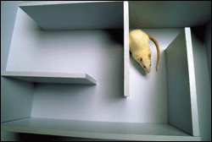
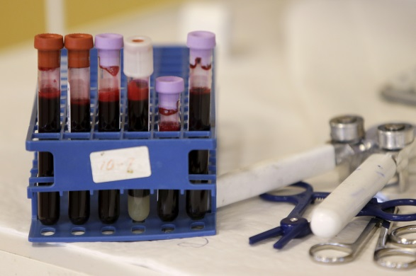
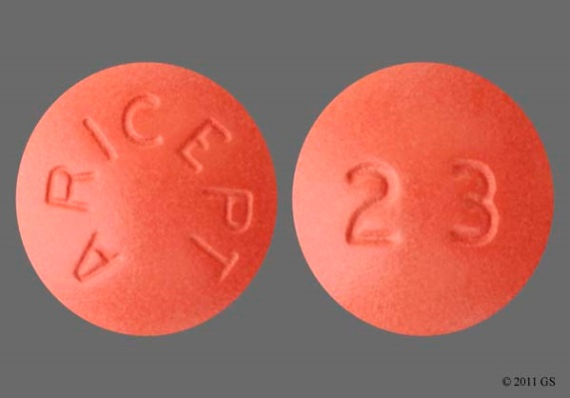
Alzheimer’s Disease: Research and Impact
Notes:
Alzheimer’s disease:
-$226 Billion to care for Alzheimer’s patients in 2015; 236 Billion in 2016, and the figure will be over $259 Billion for this year.
-With 3 decades of research there are only 5 drugs that marginally treat symptoms. There is no treatment or cure for the disease.
We all know someone who has Alzheimer’s disease and we know how it affects them and their loved ones.
There have also been several articles in the literature over the past half decade about the need for increased rigor and reproducibility in preclinical research. NIH has been leading this charge on this and placing a focus on this issue in all research areas.
Program Directors at the National Institute on Aging want to increase reproducibility in Alzheimer’s drug development studies, and ensure funding goes toward studies which follow reporting guidelines. They have worked with the National Institutes of Health Library to develop the International Alzheimer’s Disease Research Portfolio, which allows funding organizations to quickly assess who is funding what projects. Based on this success, NIA and the NIH Library teamed up to develop the Alzheimer’s Disease Preclinical Efficacy Database. This presentation will look at the need to promote rigor and reproducibility, the ontologies we have identified to help unify AD subject areas, the early feedback received for the website.

Slide 3
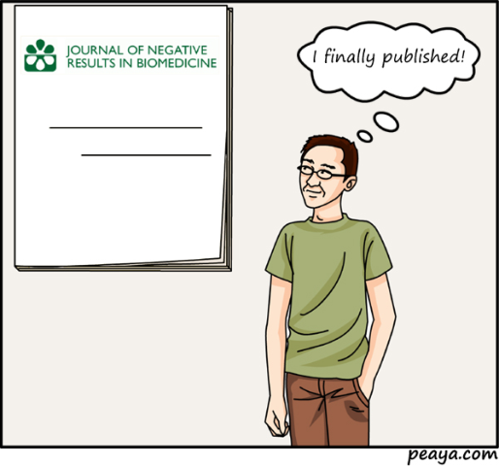
AlzPED Goals
Provide relevant detailed information about:
animal models
negative result studies
related publications
therapy approaches
model availability
related clinical trials
outcome measures
outcome parameters
Notes:
PubMed does an excellent job of indexing literature, but specific research areas with hard to treat diseases, such as Alzheimer’s disease, can benefit from specific reporting requirements. NIA Program Directors identified several key fields they wanted to include within AlzPED to focus on reporting of research to improve rigor and reproducibility specific to Alzheimer’s treatment studies(1).
The National Institute on Aging along with the NIH Library developed the following goals for AlzPED:
Provide a resource that is open to the public and easy to use
Identify critical data elements
Create a culture of rigor in both experimental design and reporting leading; to improved transparency, reproducibility and translation
Provide a place where unpublished or negative results can be shared with the research community
The ARRIVE guidelines and other sources were reviewed before a final selection of fields was made for AlzPED. Ultimately the data to be collected fell into five general areas: Bibliographic, Therapeutic Agent, Animal Model, Experimental Design, and Outcomes.

Slide 4
AlzPED Home Page
http://alzped.nihlibrary.com/
Notes:
To provide some context , I’ll provide a brief overview of the website.
Basic Home page with a large search box in the middle. About, an Advanced Search feature, Additional Alzheimer Resources, and the Submit your Data where researchers can add their own published or unpublished studies.

Slide 5
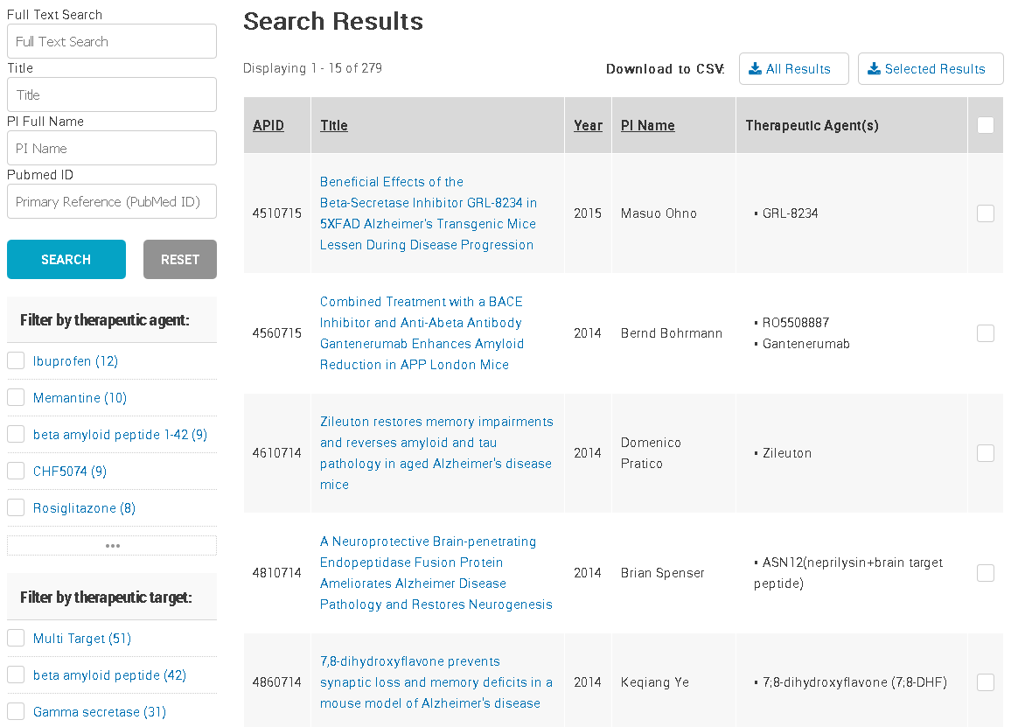
Notes:
List of results
List of specific attributes such as the Therapeutic Agents, Animal Model on the left side
Ability to export all of the data to Excel for detailed analysis

Slide 6
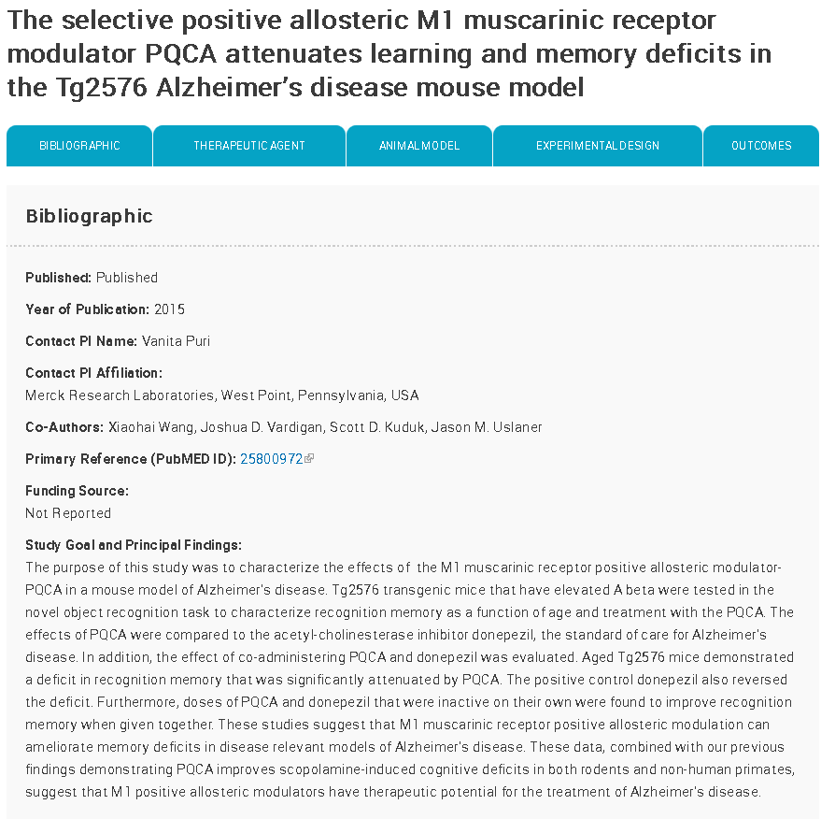
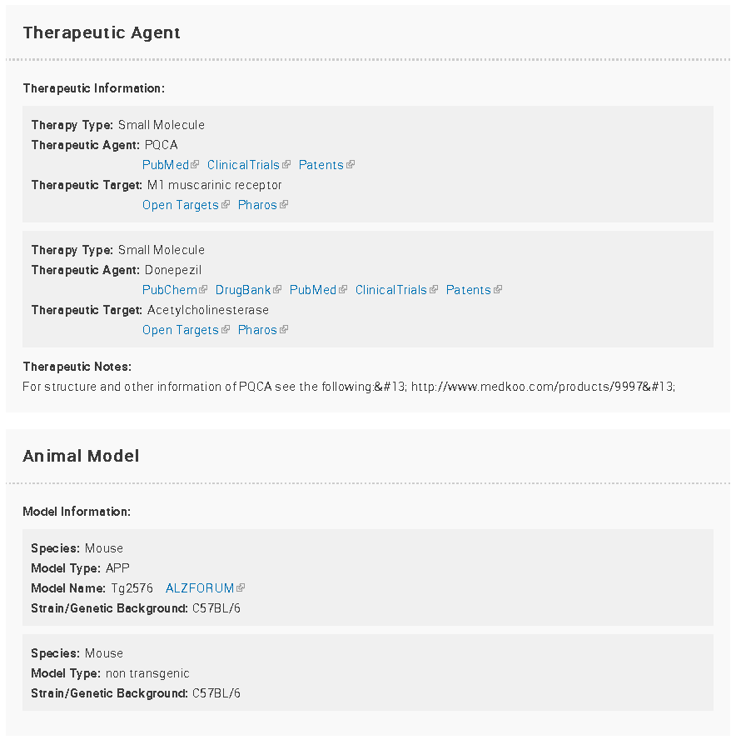
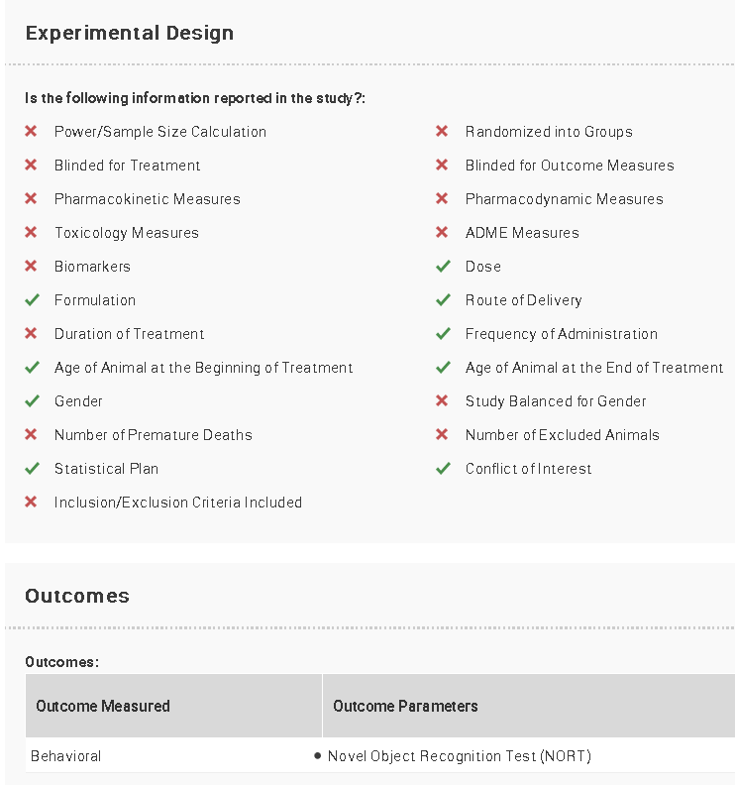
Notes:
Full record of a published study.
Link to PubMed to get the full text.
Funding information is available to speak to the study’s credibility
A detailed Goals and Principle Findings section which is different than the PubMed abstract and generally provides more detailed information about the outcomes.
There are links out to related databases providing more in depth information about specific areas such as the Therapeutic Agents, Therapeutic Targets, and Animal Models.
The Experimental Design Section – which I will talk about in more detail in a second.
Outcome Measures and their respective Outcome Parameters

Slide 7
AlzPED – Experimental Design
Notes:
The Experimental Design section was a key area for determining the rigor and reproducibility of many studies(3, 4). Originally the goal was to collect specific values for many of the experimental design elements, such as the volume and frequency agents were administered and methods used to administer those agent. However after reviewing a sample set of 35 documents it became apparent study designs can vary widely and it was going to be difficult to develop a database structure to capture all of the potential variations.
We decided knowing whether data was reported or not reported within a study was helpful, and provided enough information for someone to determine whether they wanted to view the full article or report. Thus we came up with the idea of offering checkboxes that would display as checks and X’s.
This will hopefully make investigators aware of the importance of including these factors when reporting their research.
In terms of assessing reproducibility I reviewed our data to see how many studies included some of the most important fields for that assessment. I looked at the: Power/Sample Size, Blinded for Treatment, Randomization, Blinded for Outcome Measures, Gender, Balanced for Gender, Number of Premature Deaths, Number of Excluded Animals.
There were only 25 papers out of 267 that completed at least 4 of those attributes. Only 1 paper completed 6 attributes. It would be interesting to look at those papers to see if their studies have been reproduced by others. This provides an indication that there is more work to be done to ensure the investment in these research studies is fully realized.

Slide 8
AlzPED Ontologies
Notes:
I’d like to shift gears and talk about Ontologies. The disparate terms used for naming entities within AD scientific experiments demonstrates the need for more unified ontologies around key subject areas. These areas included: Therapeutic Agents, Therapeutic Targets, Animal Models, and Outcomes Measures. This lack of clearly defined terms, makes it difficult for scientists to identify, compare and evaluate information across studies.

Slide 9
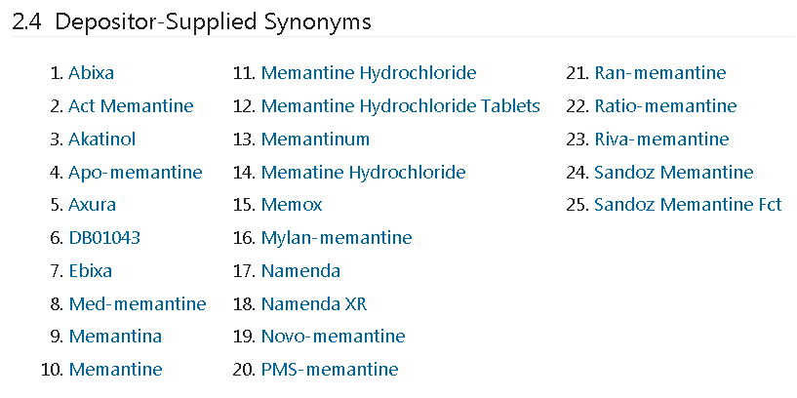
AlzPED Therapeutic Agents
Memantine – PubChem Depositor Supplied Synonyms
Notes:
Compounds can be referenced using a variety of chemical terms, which may be described and punctuated in a variety of ways. Compounds further along on the drug development pipeline can be called by their generic and brand names.
Just as one quick example this view of the Depositor-Supplied Synonymy’s from PubChem illustrates this point for the well established medication, Memantine.

Slide 10
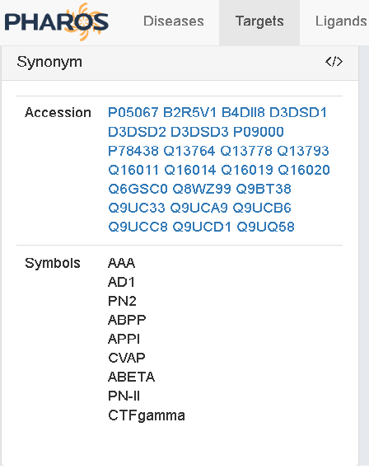
AlzPED Therapeutic Targets
Abeta protein
αβ protein
Αβ
Amyloid beta
Amyloid β
αβ peptide
Notes:
Therapeutic Targets offer their own set of ambiguous terms. For instance one of the primary targets for the treatment of Alzheimer’s disease is “amyloid beta precursor protein”. It is often referred to as APP, but it is referenced as a variety of other terms, abbreviations, and acronyms such as
1Abeta protein, αβ protein, simply αβ, Amyloid beta, Amyloid β, αβ peptide, and on and on. You see the variety of ways one might try and search for these terms.
Two to the databases we link to offer synonyms: Open Targets(5) and Pharos(6). Pharos is the Knowledge Management Center for the Illuminating the Druggable Genome, funded by the National Institutes of Health.

Slide 11
AlzPED Animal Models
Notes:
Animal models can be procured from laboratory animal model providers. Other emerging models are produced in laboratories and validated for their genetic background and pathophysiological properties.
Animal models are often described by their cell line and genetic background, but as with therapeutic agents and targets, there are multiple ways of describing cell lines and genetic grounds. These variations create obstacles in clear and consistent identification and discovery.
AlzForum provides a news website and information resource dedicated to helping researchers accelerate discovery, and they try to provide known synonyms for the various ways these models are described. Here are examples of two well known AD mouse models.

Slide 12
AlzPED – Outcomes Example
Notes:
Our Outcomes section provides a quick over view of each study’s outcomes and unifies the terminology used to describe outcomes and their parameters.
Dr. Refolo has delineated 14 Outcome Measures . Over 400 parameters have been identified as measurements of treatment effectiveness. These parameters often seem to be very similar but are measuring very discrete things.

Slide 13
AlzPED – Early Feedback
We wanted feedback on:
The organization of information
The navigation of the tool
The Search capabilities of the tool
The value of the content
Would this help them to make research decisions
Notes:
AlzPED is still very young and not well known in the Alzheimer’s disease research community. A few presentations have been made to communities such as this, and to the Neuroscience Community. It will be presented during the Alzheimer’s Association International Conference in London next month. Feedback about AlzPED has been collected by conducting beta tests, looking at usage statistics.
We interviewed groups from the NIH Library, the University of Maryland, and Funding Leaders within the AD Research Community.

Slide 14
Beta test – Critic
“Glossary of terms would be really helpful. That might placate some of these issues. Perhaps employ an “Consider Using these Terms”
“Findability – Sample searches: “3xTg” = 18 hits; “3xTg-AD” = 10 hits; “3xTgAD” = 1 hit; “triple transgenic” = 6 hits; “APPxPS1xTau” = 17 hits”
“Variability in results is problematic”
“No internal controlled vocabulary to pick up synonyms; users will become frustrated as a result because it will not be usable.”
Notes:
It was noted by multiple beta testers that the biggest weakness in Alzheimer’s research is the inability to unify concepts because of the variety of synonyms, terms, and abbreviations used to describe the same thing. This also seems to be a general complaint from investigators in the research community.

Slide 15
Beta test – Critic
“Information is a little tricky to be discoverable by a general researcher. For instance, if they’re utilizing a specific term or abbreviation (ex. ABP), only one result will come up. However, if they typed in Amyloid beta Peptides, they’ll have 92 results.”
“Searchers may want to filter results according to the Quality Measures in the Experimental Design section.”
“Curious about the ease of making edits and what that process is. Not knowing that might make me reluctant to add data to the repository.”
Notes:
Additional comments offer good information about how users may want to use the database for analysis, and to add their own information.

Slide 16
Beta test – Positive comments
“Very helpful in allowing investigators to take a quick look to see what is out there, see what work could be done in-house, and assess what work could be done more quickly. It allows the investigator the ability to assess more accurately what resources need to be brought to the investigation in terms of time and budget.”
“Love what you are doing; providing the ability to drill down to the disease; assist translational research; highlight key elements. Disconcerting how my own publication rated in the assessment. I had some of that information and did not include it in the publication.”
Notes:
Positive comments from leaders in the AD Funding community included those show:
Additional comments include: “Easy to navigate, easy to search, the content is helpful.” They find value in using the system, and believe it will help change the culture of sloppy reporting.

Slide 17
Beta test – Positive comments
“It will change the culture when people have to enter their own studies, and they know they have to address all of these issues [Experiment Design].”
“This offers one less step of searching which is nice for someone reviewing studies in the discipline or collecting information.”
“A great site for preclinical models as long as scientists populate it. It is easy to navigate, has a lot of functionality and is easy to upload data. The search function was fantastic.”
Notes:
Comments from experienced researchers and funders included: They find value in using the system, and believe it will help change the culture of sloppy reporting.

Slide 18
Summary Point
There needs to be more Rigor and Reproducibility in Alzheimer’s disease laboratory research.
AlzPED can help bring these needed changes.
A standardize Ontology will also likely help improve discovery of information and comparisons between studies.
Feedback has been encouraging and many advocate adding unpublished studies to the database.

Slide 19
AlzPED Team
Dr. Lorenz Refolo
Dr. Suzana Petanceska
Dr. Zane Martin
Ms. Cindy Sheffield
Ms. Katarina Mancevska
Notes:
I would like to thank all of my team mates for their help and support in this project.

Slide 20
Contact Information
Cindy Sheffield, MLS, MBA
AlzPED Project Manager Zimmerman Associates, Inc. - Contractor National Institutes of Health Library
cynthia.sheffield@nih.gov
Notes:
Contact information

